Slide 1






DOCTOR APPOINTMENT BOOKING SYSTEM

Slide 2


Project Overview
The Doctor Appointment Booking System is an online platform designed to facilitate the scheduling of appointments between patients and healthcare providers.
The system allows patients to easily book, reschedule, or cancel appointments while providing doctors with a streamlined way to manage their schedules.
Key features include real-time availability, a secure database for patient records, and a Doctor Dashboard for appointment tracking and earnings management.

Slide 3
Introduction to Tools
Front End Tools
▪ Tailwind CSS:
A utility-first CSS framework for styling user interfaces with minimal custom CSS.
▪ React.js:
A JavaScript library for building user interfaces, allowing for reusable UI components.
Back End Tools
▪ Node.js:
A JavaScript runtime for developing scalable server-side applications.
It is used in conjunction with Express.js to create RESTful APIs that handle requests from the front end, manage database interactions, and implement logic.
Express.js:
A Node.js web framework used to create RESTful APIs and handle routing.
MongoDB:
A NoSQL database that stores data in flexible. MongoDB is used for storing user information, Appointment details, Patient Information and Doctor-related data.

Slide 4


System Study
• Existing System:
Traditional methods of booking doctor appointments is primarily manual, involving phone calls or in-person visits. This leads to inefficiencies such as long wait times, double bookings, and miscommunication between patients and healthcare providers.
• Proposed System:
The proposed system is an online application that allows patients to book appointments conveniently. Features include real-time availability, a Doctor Dashboard, an Admin Dashboard and secure patient information storage.

Slide 5

Cont..
• Scope of the Proposed System:
o The system will cater to various healthcare providers, including hospitals, clinics, and individual practitioners. It will support multiple specialties and allow for integration with existing healthcare management systems.
• Aim and Objective of the Proposed System:
1. Provide a user-friendly interface for patients to book appointments.
2. Reduce administrative workload for healthcare providers.
3. Enhance communication between patients and doctors.
4. Maintain a secure database of patient information and appointment history.
5. Implement a Doctor Dashboard for tracking appointments and earnings.

Slide 6


Feasibility Study
Operational Feasibility
The system is operationally feasible as it simplifies the appointment booking process, making it more efficient for both patients and healthcare providers.
Technical Feasibility
The technology stack chosen is widely used and supported, ensuring that the system can be developed and maintained effectively.
Economic Feasibility
The cost of development and maintenance is justified by the expected increase in patient satisfaction and efficiency.

Slide 7

Features
User Registration & Login
Doctor and Admin Login
Appointment Booking System
View & Manage Appointments
Doctor Dashboard with Earnings & Availability Management
Automatic Status Update for Past Appointments
Patient Information Storage & Access
User Profile Viewing & Editing
Admin Panel for Managing Doctors and Appointments

Slide 8
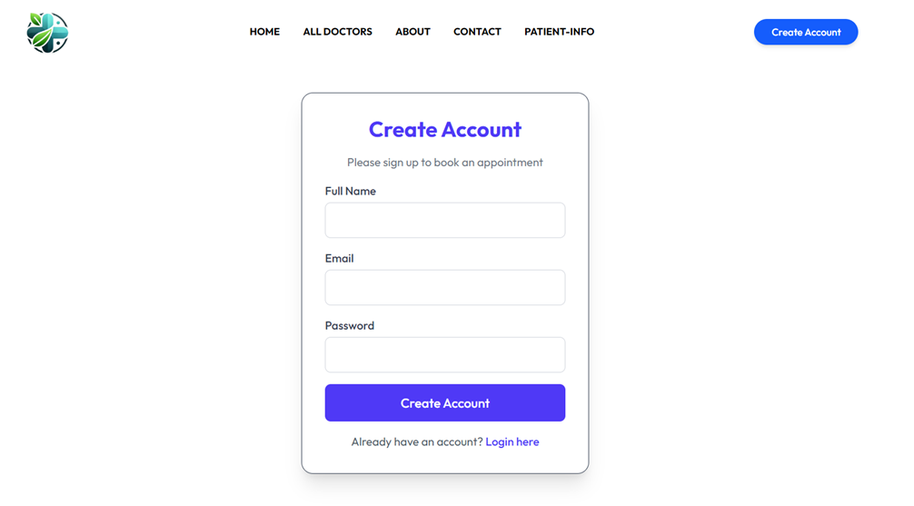
User Flow for Patients/Users
Register/Login to the system:

Slide 9
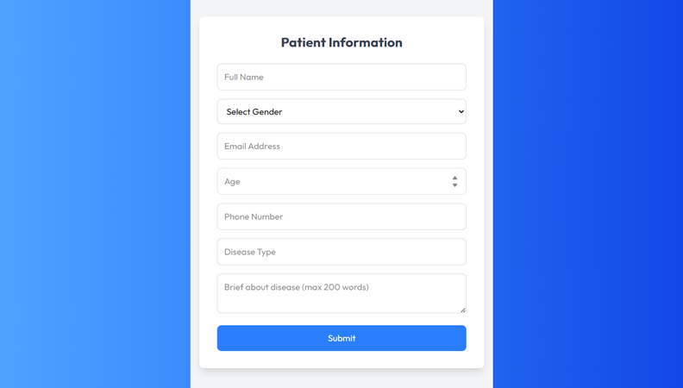
User Flow for Patients/Users
2. Fill out the patient information form:

Slide 10
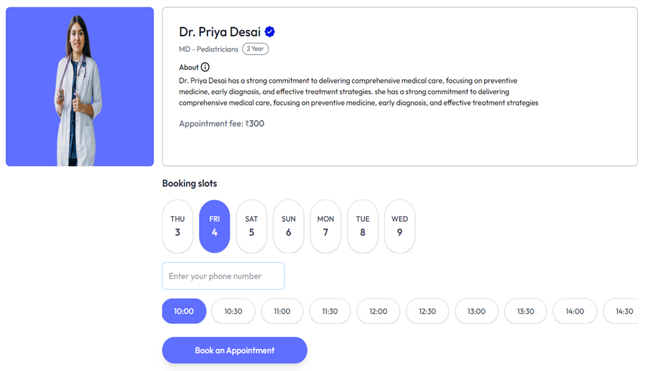
User Flow for Patients/Users
3.Enter phone number to proceed
4.Select a doctor & choose an available slot:

Slide 11
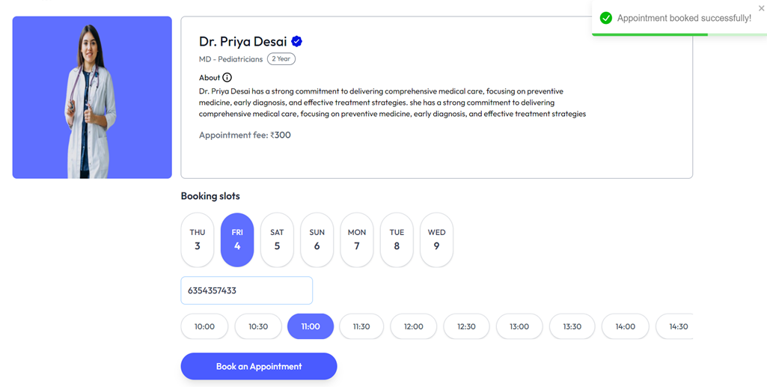
User Flow for Patients/Users
5.Provide Details & Confirm Booking:

Slide 12
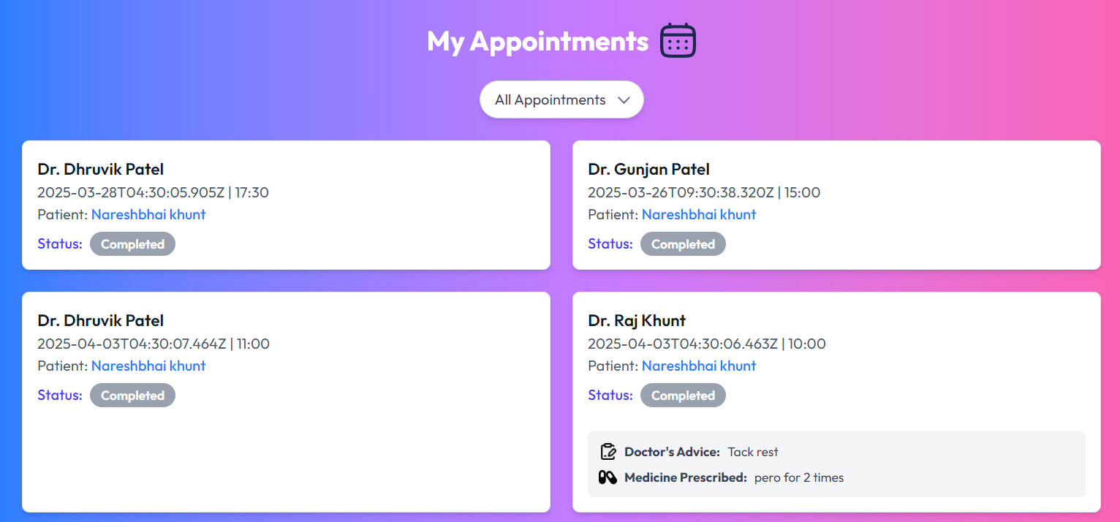
User Flow for Patients/Users
6.View appointment status on 'My Appointments' page:

Slide 13
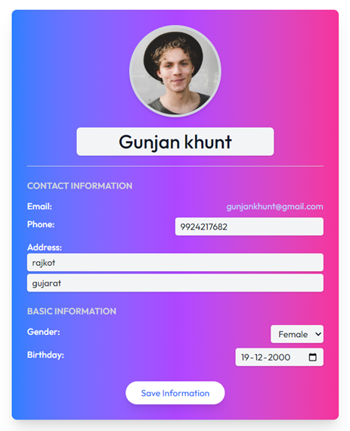
User Flow for Patients/Users
7.View and update personal profile:

Slide 14
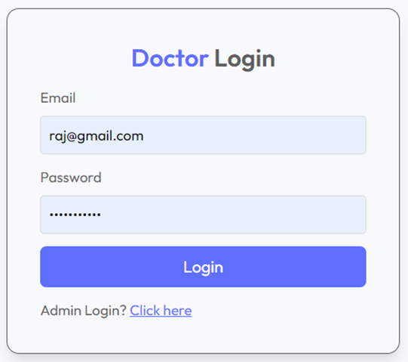
User Flow for Doctors
1. Login to Doctor Dashboard:

Slide 15
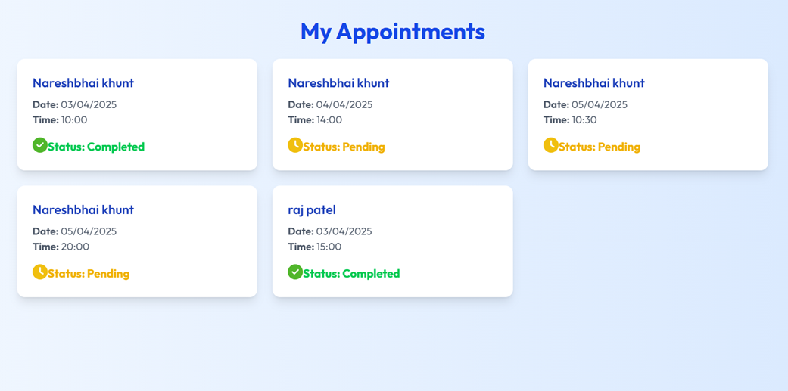
User Flow for Doctors
2. View Upcoming & Completed appointments:

Slide 16
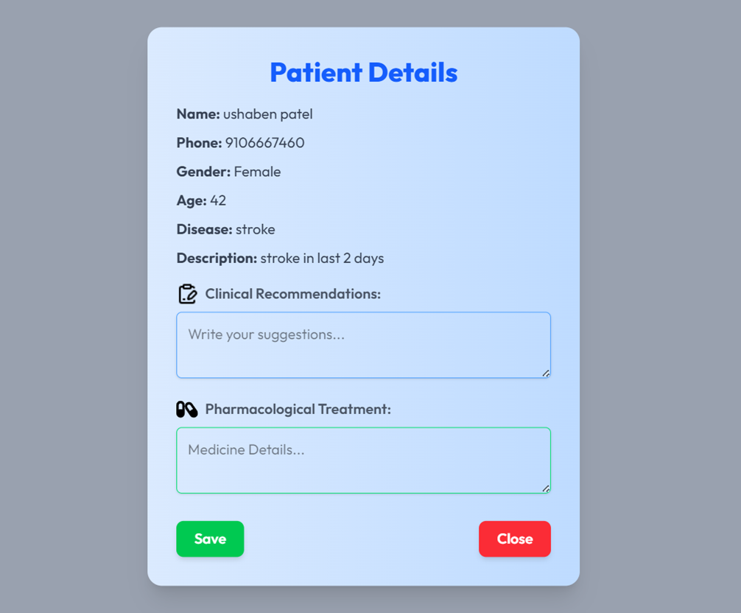
User Flow for Doctors
3. Click on an appointment to view detailed patient information:
4. Fill in suggestions & prescribe medication:

Slide 17
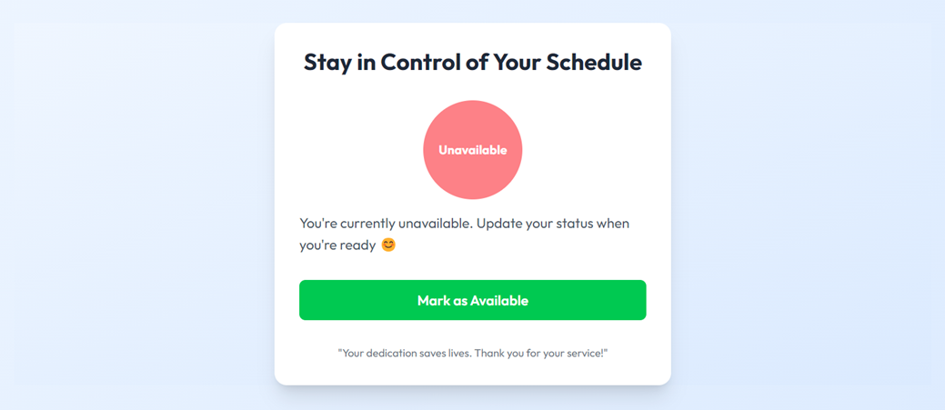
User Flow for Doctors
5.Update Availability status:

Slide 18
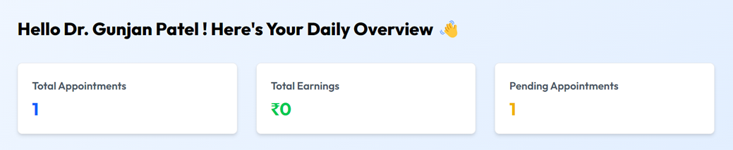
User Flow for Doctors
6. View earnings & Total and Pending Appointments:

Slide 19
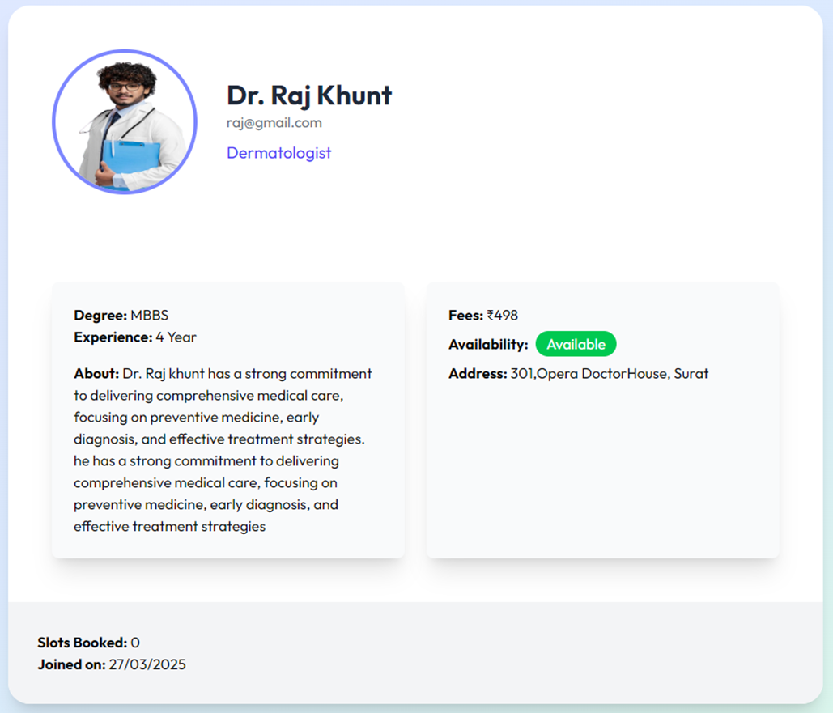
User Flow for Doctors
7. Doctor Profile

Slide 20
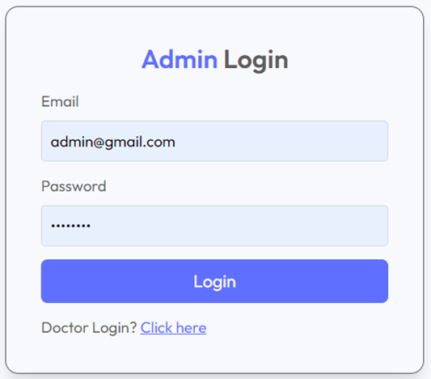
User Flow for Admin
1.Login to Admin Panel:

Slide 21
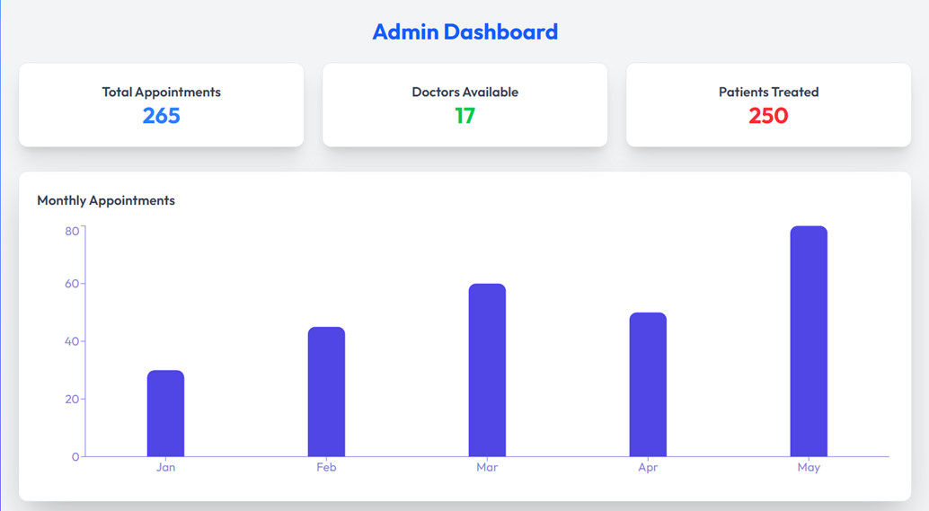
User Flow for Admin:
2. Dashboard:

Slide 22
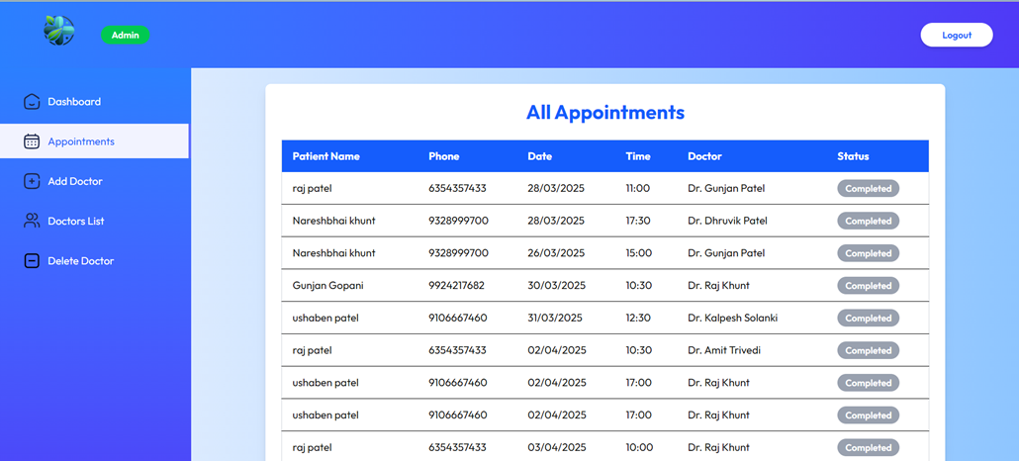
User Flow for Admin:
3. View all appointments:

Slide 23
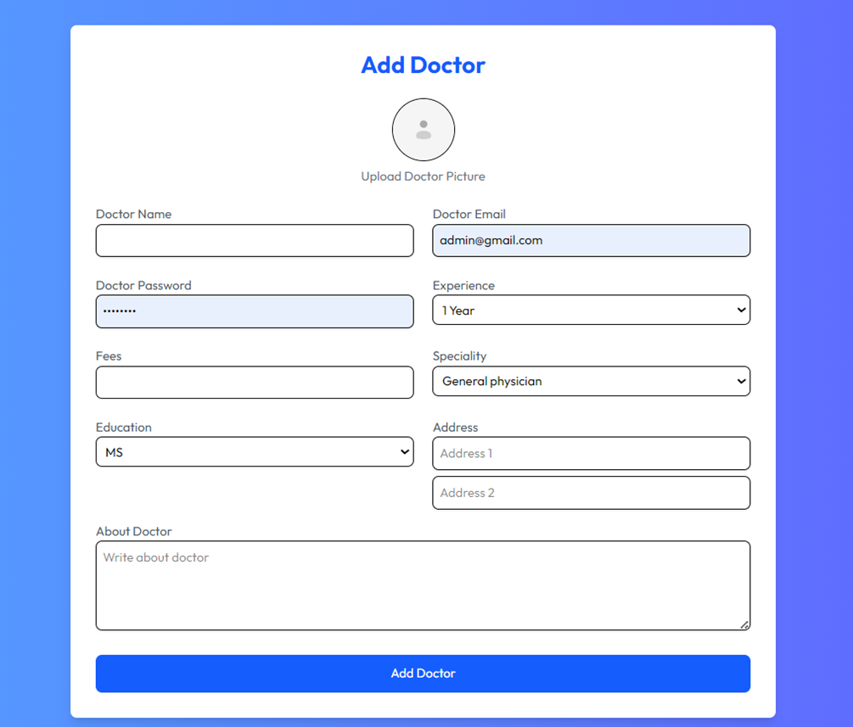
User Flow for Admin:
4.Add/Delete doctors:

Slide 24
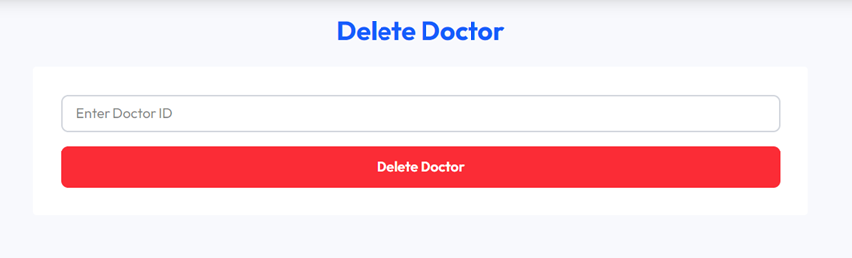
User Flow for Admin:
• Enter Doctor ID for Delete:

Slide 25
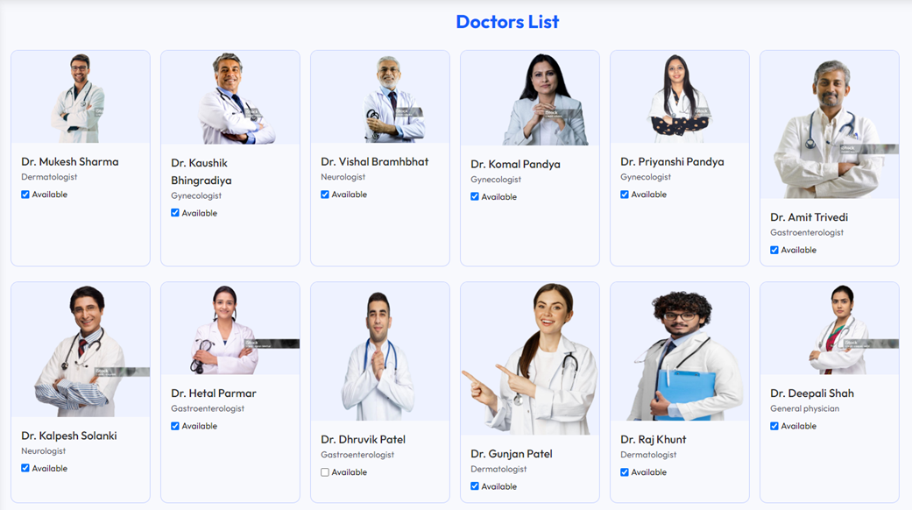
User Flow for Admin:
5.Doctors List

Slide 26
System Analysis
Requirements Specification:
User Registration/Login Module: Patients and doctors can create accounts and log in using their email and password.
Appointment Scheduling Module: Enables patients to book, reschedule, or cancel appointments.
Doctor Dashboard: Doctors can view their appointments, earnings, and pending consultations.
Appointment Status Management: Appointments automatically update to 'Completed' once the scheduled date has passed.
Patient Info Section: Collects and stores patient details, including name, gender, email, disease type, and a brief description.
Doctor's Notes Module: Doctors can view detailed patient information and add suggestions or medicine-related notes, which are stored in the database.
Admin Module: Administrators can manage doctors, and
appointments.

Slide 27
Future Enhancements
1. Smart Features
AI-based Doctor Recommendation: Suggest doctors based on patient symptoms and previous bookings.
Chatbot for Instant Help: Integrate a chatbot to assist patients with bookings, FAQs, etc.
2. User Experience (UX) Improvements
Push Notifications: Notify patients and doctors about upcoming appointments, changes, or reminders.
Live Appointment Tracking: Real-time status updates (e.g., "Doctor is running 10 mins late").
Multi-language Support: Add regional language options for broader accessibility.

Slide 28


Thank You

